Slide 1
Leverage the Microsoft Graph & 3rd Party APIs
Calling Azure AD Protected 3rd Party REST APIs

Slide 2

Calling Azure AD Protected 3rd Party REST APIs
Azure AD Protected Resources & SPFx: How it Works
Permission Requests
SPFx’s AadHttpClient

Slide 3
Securing REST APIs with Azure AD
Resources in Azure can be easily secured with Azure AD
Requires a request to include a valid OAuth access token in the HTTP header on request
Similar to how existing services are secured
SharePoint REST API
Microsoft Graph API
Azure Management REST API
etc.

Slide 4
Securing Azure Functions

Slide 5
Securing Azure Functions

Slide 6
Calling Azure AD Secured Resources from SPFx
Permission requests to resources are granted to special SharePoint app by tenant admin
SharePoint Online Client Extensibility Web Application Principal
Present in each SharePoint Online tenant
Permissions are unique to the tenant, not the SPFx solution
Once a permission is granted, all solutions can leverage the grant
Permission grant is valid until revoked
Permission grant not directly linked to the solution that requested it
Solution installation not linked to permission grant approval / rejection

Slide 7
Granting Permissions to SharePoint Online
Special SharePoint Online Azure AD app can be granted permissions to resources in multiple ways:
Defined within solution manifest – admin notified upon deployment to approve/reject
PowerShell
Office 365 CLI
Ref: https://docs.microsoft.com/sharepoint/dev/spfx/use-aadhttpclient

Slide 8
SPFx Solutions Declare Permission Requests
// package-solution.json
{
"$schema": "https://developer.microsoft.com/json-schemas/spfx-build/package-solution.schema.json",
"solution": {
"name": "sp-fx-aad-http-client-side-solution",
"id": "dfb230b7-4f61-431f-9b65-a34e83922663",
"version": "1.0.0.0",
"includeClientSideAssets": true,
"webApiPermissionRequests": [
{ "resource": "Microsoft Graph", "scope": "User.ReadBasic.All” }
]
},
"paths": {
"zippedPackage": "solution/sp-fx-aad-http.sppkg"
}
}

Slide 9
How It Works: Calling Azure AD Secured REST APIs from SPFx

Slide 10
Using the Azure AD HTTP Client
import { AadHttpClient, HttpClientResponse } from '@microsoft/sp-http';
this.context.aadHttpClientFactory
.getClient([name / URI of target resource])
.then((aadClient: AadHttpClient) => {
const endpoint: string = 'https://secured endpoint'
aadClient.get(endpoint, AadHttpClient.configurations.v1)
.then((rawResponse: HttpClientResponse) => {
return rawResponse.json();
})
.then((jsonResponse: any) => {
// work with result
});
});
});

Slide 11
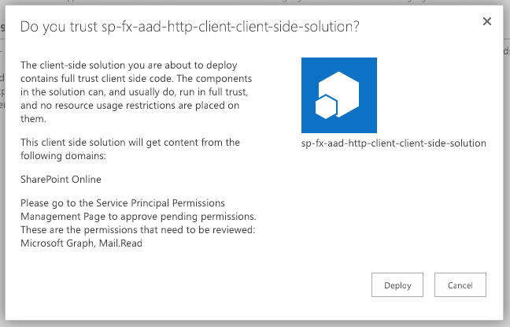
Add SharePoint Package to SharePoint App Catalog
Upload SharePoint packages to the app catalog
Extra note in dialog notifies of additional step required
While application can be installed in SharePoint sites, it does not have the permissions granted that it needs to access Azure AD protected resources

Slide 12
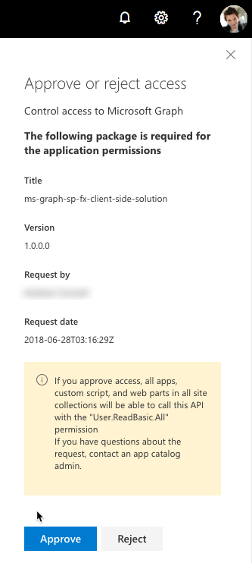
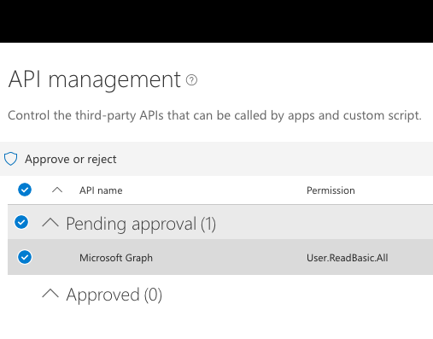
Approve / Reject with SharePoint Online API Management Page

Slide 13
Demo Calling the Microsoft Graph

Slide 14

Summary
Azure AD Protected Resources & SPFx: How it Works
Permission Requests
SPFx’s AadHttpClient

Slide 15
Reading further
SharePoint Framework
https://docs.microsoft.com/sharepoint/dev/spfx
Connect to API Secured with Azure Active Directory
https://docs.microsoft.com/sharepoint/dev/spfx/web-parts/guidance/connect-to-api-secured-with-aad
Connect to Azure AD-secured APIs in SharePoint Framework Solutions
https://docs.microsoft.com/sharepoint/dev/spfx/use-aadhttpclient

Slide 16
Thank you.

